Slide 1

SQLITE

Slide 2
INTRODUCTION
SQLite is an open-source relational database
SQLite supports all the relational database features.
Used to perform database operations on android devices
It is embedded in android by default
Lightweight SQL database implementation that stores data to a text file on the device

Slide 3
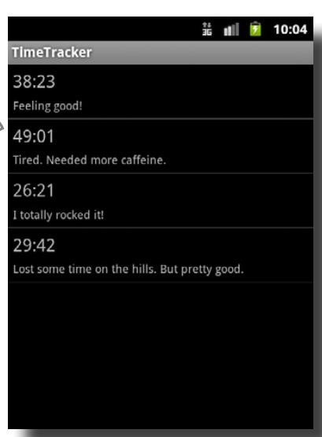
EXAMPLE APP
Using CustomAdapter with 2 TextView
Create java object match with 2 TextView (Model class)
CustomerAdapter implements getView() Methods

Slide 4
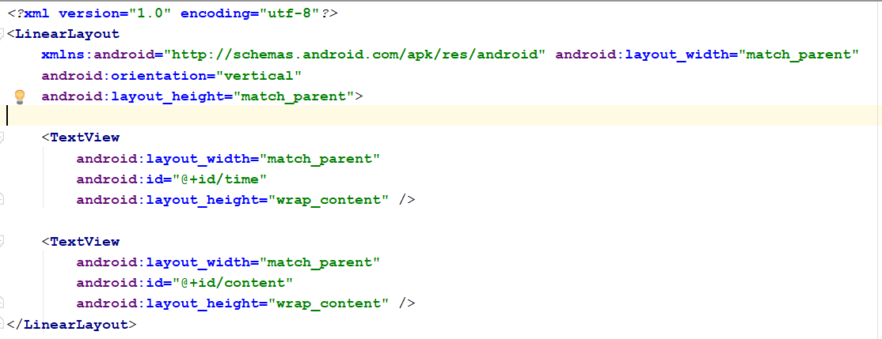
EXAMPLE APP
ListView layout

Slide 5
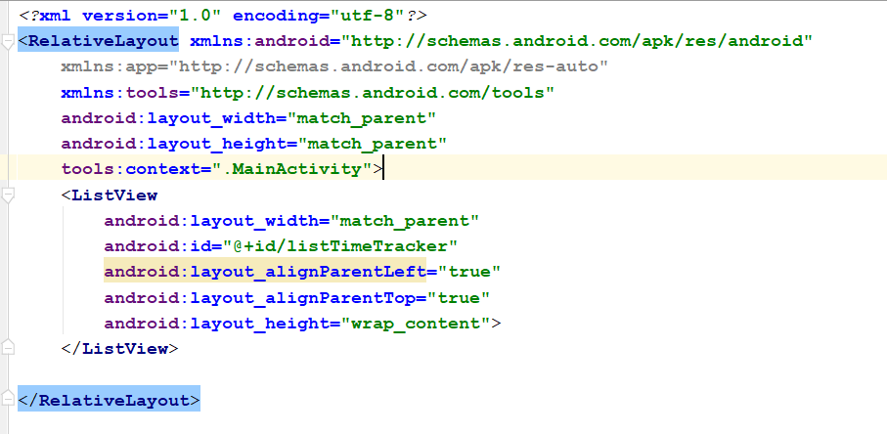
EXAMPLE APP
MainActivity layout

Slide 6
EXAMPLE APP
MainActivity layout

Slide 7
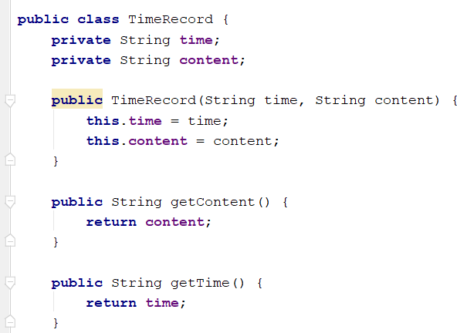
EXAMPLE APP
MODEL CLASS

Slide 8
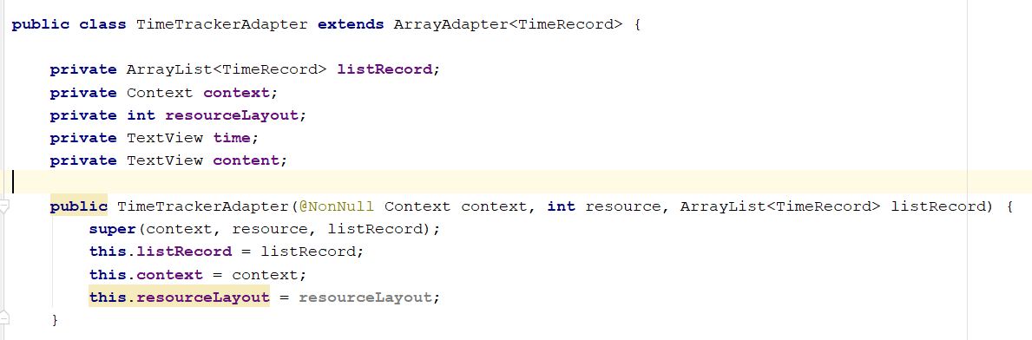
EXAMPLE APP
CUSTOM ADAPTER CLASS

Slide 9
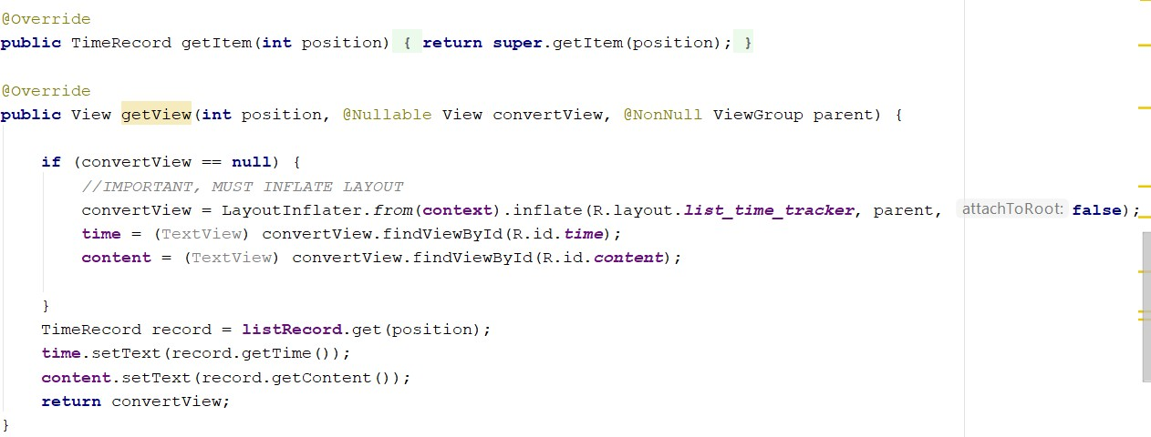
EXAMPLE APP
CUSTOM ADAPTER CLASS

Slide 10
QUESTION
WHAT HAPPEN IF STOP APP AND START AGAIN ?
HOW TO CONVERT TO SQLITE

Slide 11
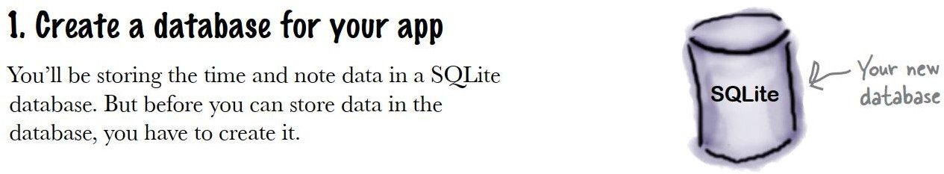
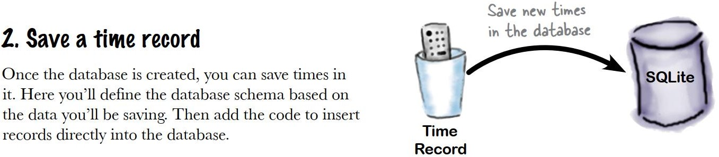
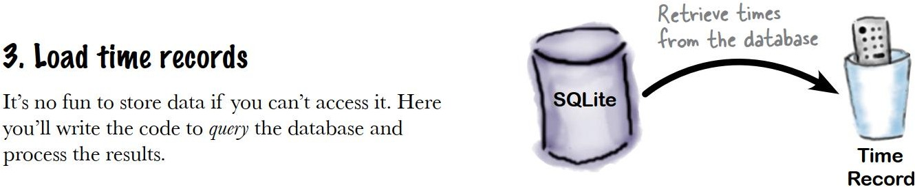
STEP TO DO

Slide 12
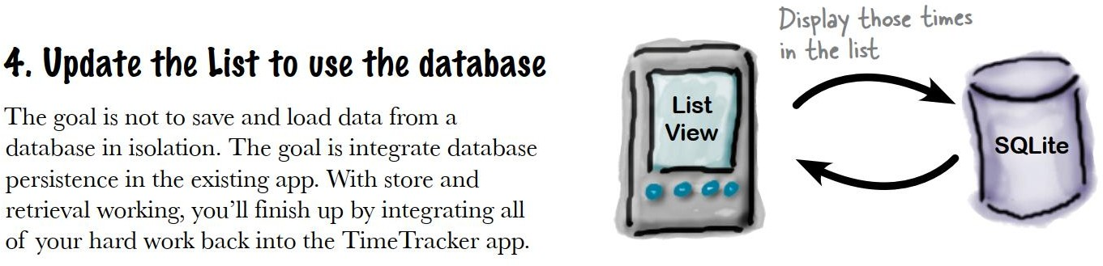
STEP TO DO

Slide 13
CREATE DATABASE
Use SQLiteOpenHelper that provides
you with all of the basic behavior to manage a database.
Create a new class that extends SQLiteOpenHelper
There are three methods you’ll need to implement that descrive how to connect to your database, initially create tables, and upgrade from previous versions.

Slide 14
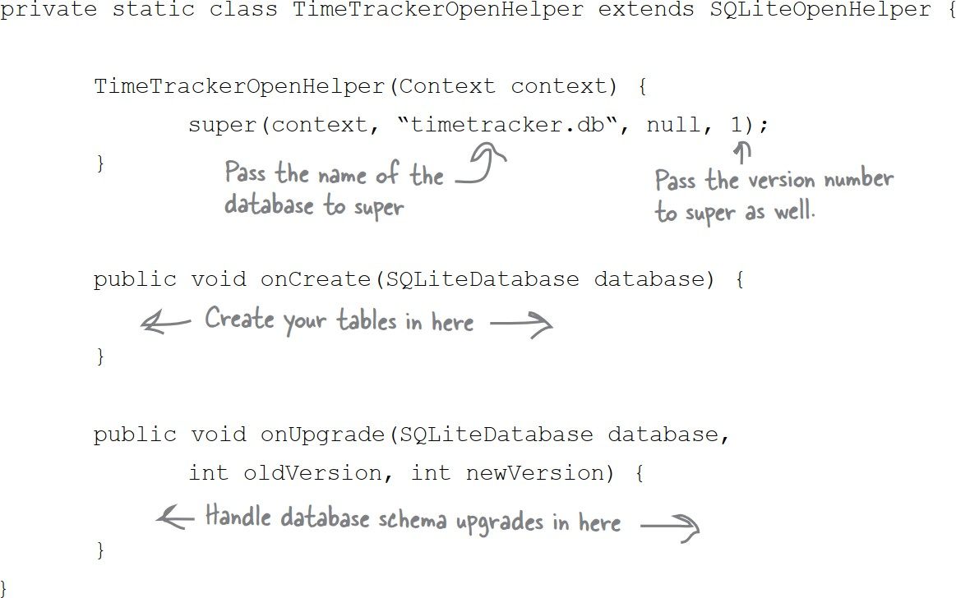
CREATE DATABASE

Slide 15
TEST DATABASE
In MainActivity, run code below then we will see database name, database file location
Open databasefile with SQLiteBrowser will see database

Slide 16
DESIGN DATABASE
Database will be created when call helper class but it is empty
How many field you want ? What is primary key
In this lab, we will have time, notes (content)
and 1 more field (id is primary key)

Slide 17
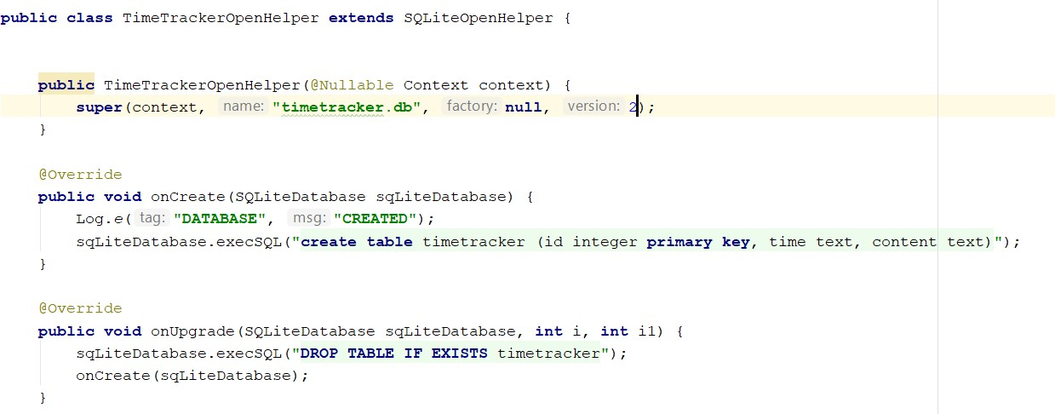
DESIGN DATABASE

Slide 18
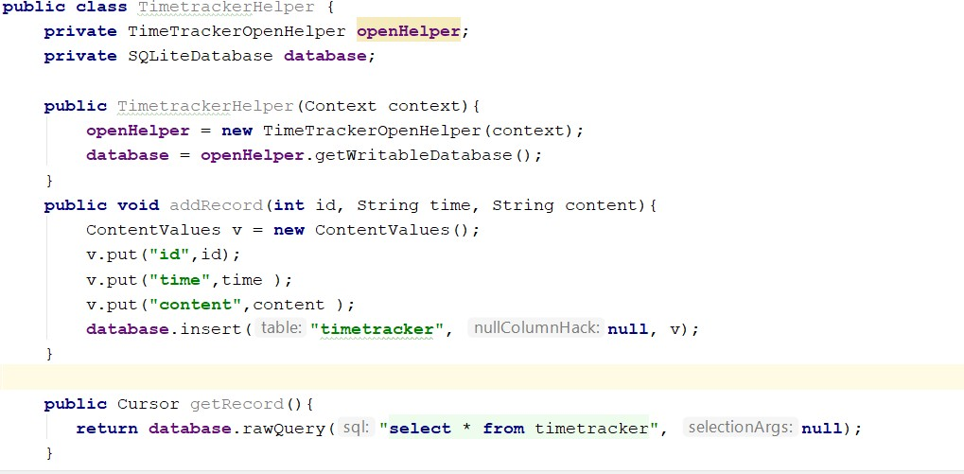
INSERT DATA TO DATABASE
CREATE ANOTHER CLASS FOR OPERATION

Slide 19
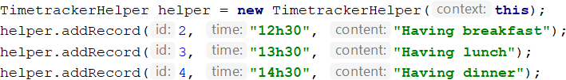
INSERT DATA TO DATABASE
Insert data in MainActivity, This is just for testing, in real application, data only add in event
After that view database file if record inserted

Slide 20
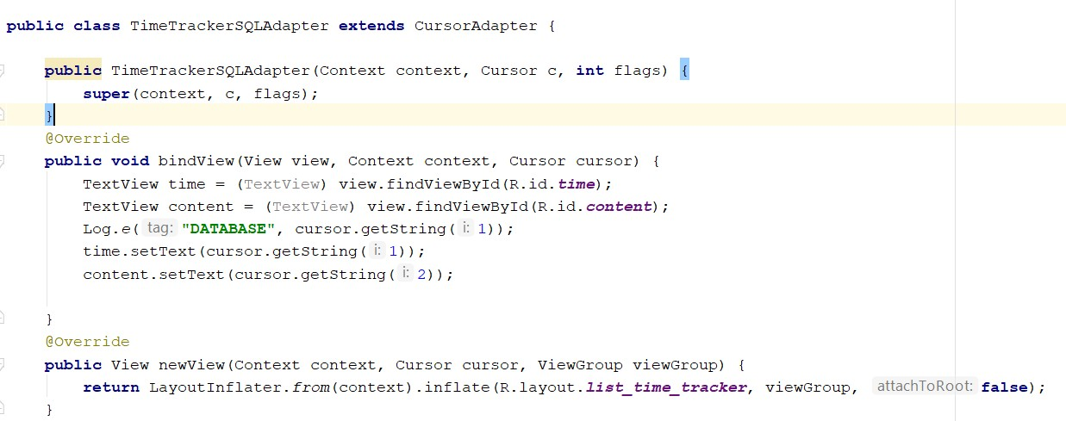
GET DATA AND DISPLAY IN LISTVIEW
Change to Custom CursorAdapter

Slide 21
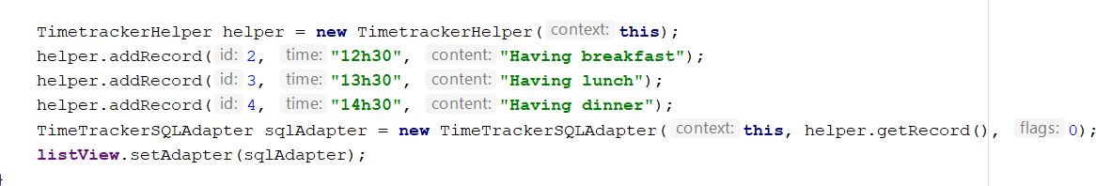
GET DATA AND DISPLAY IN LISTVIEW
Change adapter in ListView

Slide 22
QUESTION
&
THANK YOU FOR YOUR ATTENTION

